Slide 1


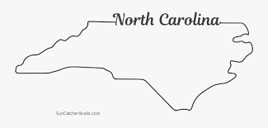


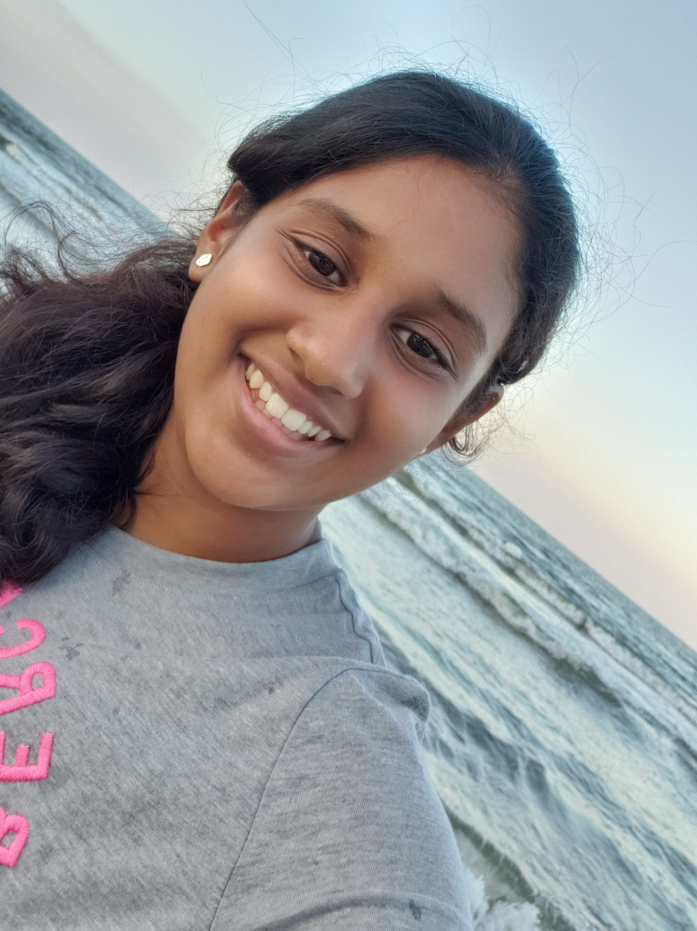


Nidhi Vankadaru
I was born in North Carolina
My birthday!
I love pasta and I'll basically eat anything with cheese on it
I have a pretty small family. Just me and my parents. No pets.
I listen to mostly pop and a little bit of k-pop.
I play tennis, I was on the 7B girls B-Ball team and I dance

